Slide 1
ADS ML – Week 3 Exploring Data with Python & Tableau

Slide 2
Goals: At the end of this lesson …
You can apply a few useful new exploration plot types.
You learn to think about trends, outliers and clusters.
You can use Tableau to explore data and answer questions in the form of a dashboard.

Slide 3
Contribution to the learning objectives
create a visualization from any data set that is not misleading and that clearly shows clustering, outliers and trends,
motivate every design choice in a created visualization,
motivate the next step in a data analysis based on a given visualization,
present data analysis and visualizations as part of reproducible research,
apply narrative techniques in visualizations,
create engaging visualizations that allow for data exploration and story progression.

Slide 4
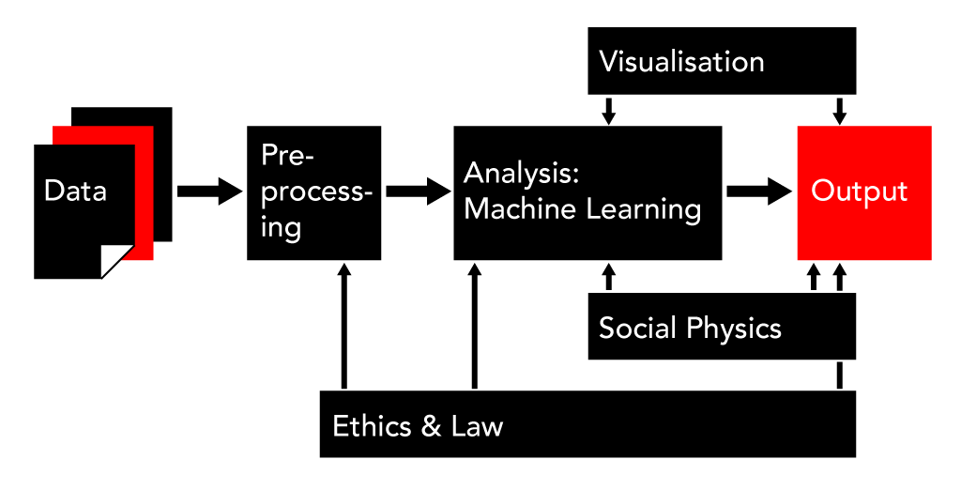
What are we doing?
Exploration
Presentation

Slide 5
Outliers, trends and clusters

Slide 6
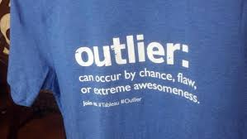
Outliers, trends and clusters.
Data exploration usually starts by asking questions about your data.
Outliers
What is the best/highest …?
Trends
How does … change with …?
Clustering
How is … distributed?

Slide 7
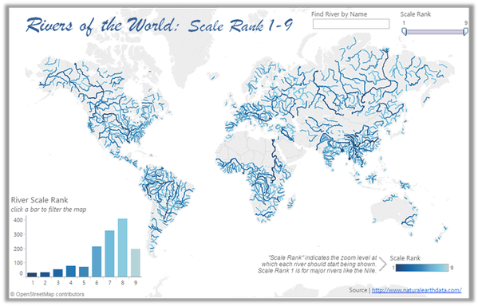

Slide 8
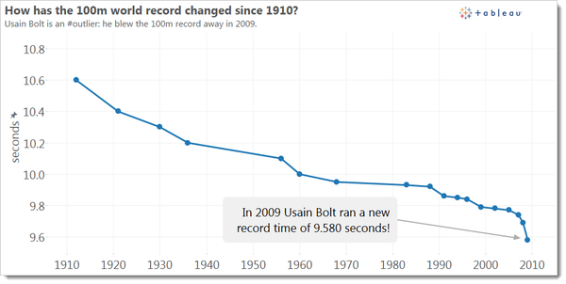

Slide 9
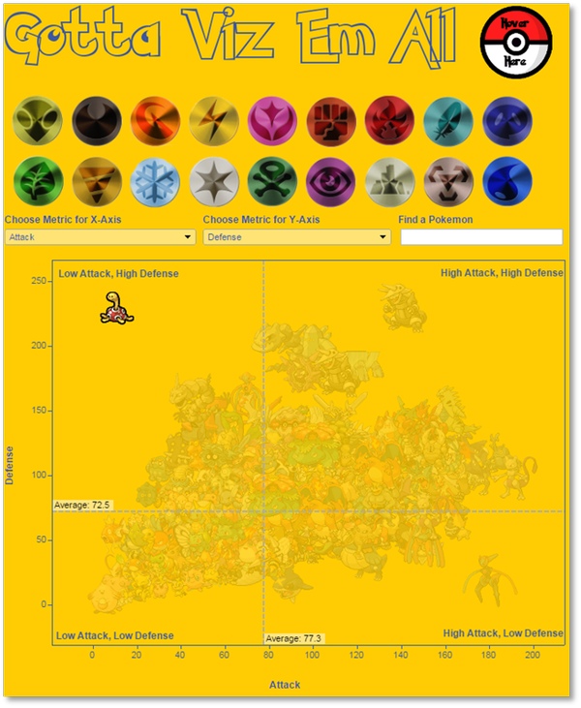

Slide 10
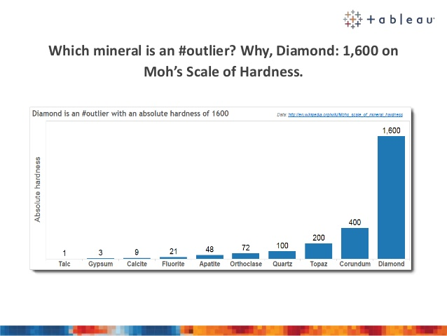

Slide 11
Data exploration in Python

Slide 12
Data exploration in Python
We have seen the basic plots like scatter, bars and histograms.
Do you know the useful plotting charts: parallel coordinates and scatter matrix?
Find out by doing assignment 1 of this week. (30min)
https://github.com/olafjanssen/ads-dv

Slide 13
Tableau

Slide 14

Plotting with Tableau
Tableau is a very popular visualization tool among BI people and data analysts.
It is very powerful for visualization with a design-rule friendly workflow.
Target audience is usually not the general public.
http://www.tableau.com/

Slide 15
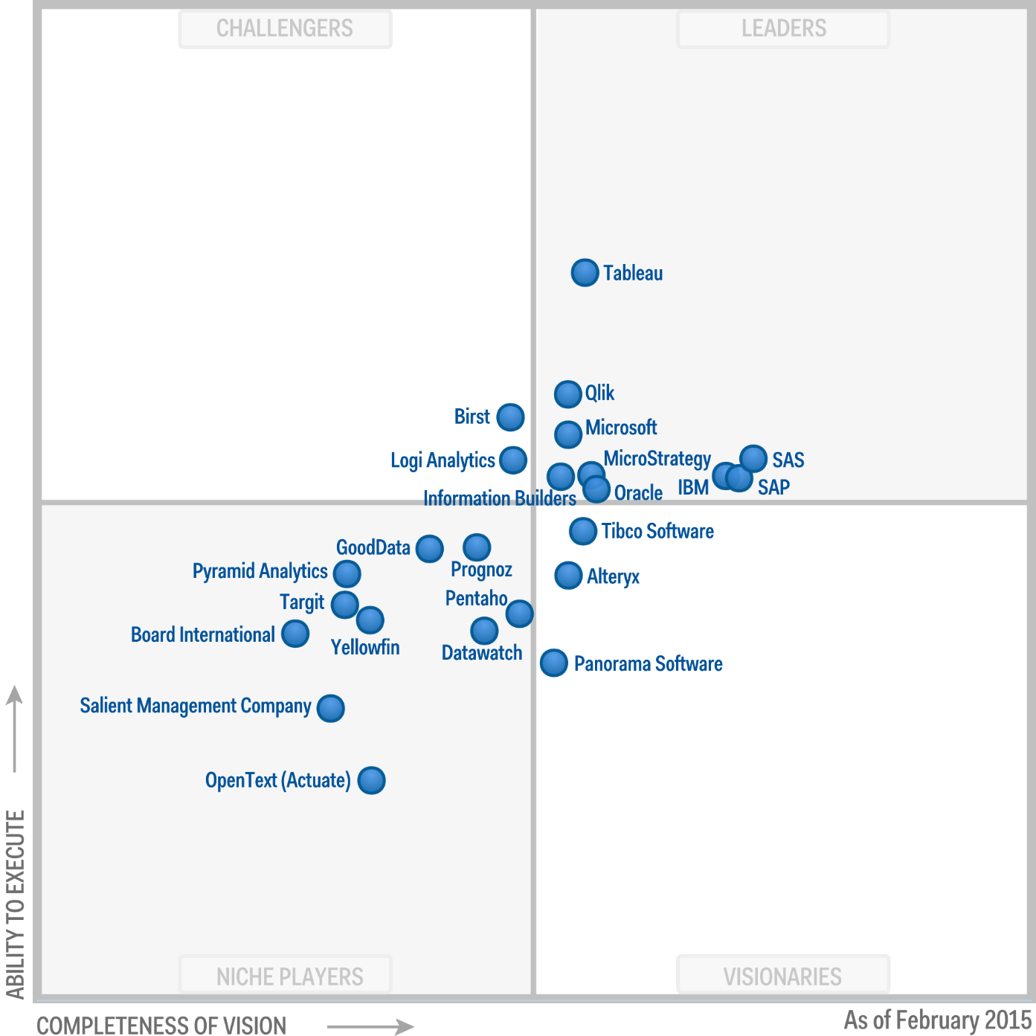

Slide 16
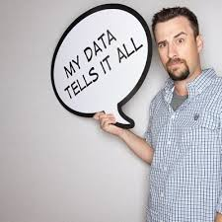
Why Tableau?
Allows for connecting with Big Data sources such as Spark and MongoDB.
Simple for the exploration phase.
Allows also for publishing online interactive visualizations with storytelling elements.

Slide 17
Assignments 2 - 4
Practice with Tableau using predefined tutorials.
Create a dashboard using your own questions and dataset of choice.
(Optional) Recreate it in iPython as part of reproducible research.
Before week 4:
Watch lectures 1a en 2a of the Udacity MOOC Data Visualization and D3.js and create your own cheat sheet, with all the design rules and tips!

